Slide 1

Threat modelling
Rolls Royce
Luke Thomas
N.Luke.Thomas@Rolls-Royce.com
Aayush Mailarpwar
Cooper Zuranski
Joe Swiney
Kristopher Bright
11/18/2022

Slide 2
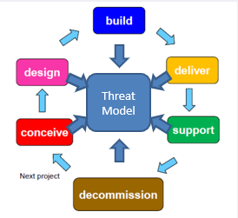
MOTIVATION
Kris Bright
The goal is to create awareness about the possible threats
Recently more and more devices have become interconnected
Security is mainly an afterthought
There are very few security experts
Give someone with no background in security the ability to identify vulnerabilities

Slide 3
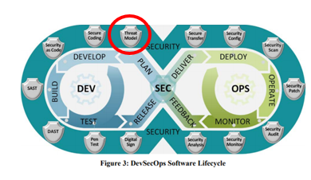
Background
Kris Bright
Threat modeling is used to analyze, discover and describe vulnerabilities in systems
Threat modeling describes what is being modeled in more context than just security first.
Threat modeling can be used for security systems, aircraft, automobiles, embedded controls, phones, cameras, wireless equipment, and even things as simple as physical rooms.

Slide 4
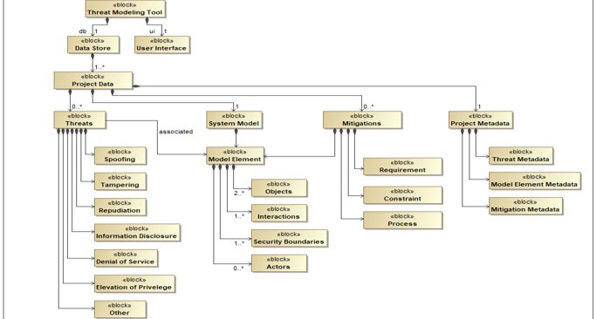
System Diagram
Kris Bright

Slide 5


Project Requirements
Aayush Mailarpwar
Technical Requirements
User Interface – Extremely simple GUI (WYSIWYG)
Assisted Function – ToolTips, Visual Guidance, On/Off Capabilities
Import/Export Functionality
Save and Load
Version Controlled – GitHub
Frontend and Backend : Angular and Python
Extendable code (Minimum Viable Product)
Maintainable code

Slide 6

Requirements continued
Aayush Mailarpwar
Standard Requirements
Open Source
Regular Coding standards
Push/Pull request
Using branches on version control not main
Constraint Requirements
No admin
Colorblind adaptability
Testable code
Unix style time recording
Capability to run on any average laptop

Slide 7


Design options
Joe Swiney
1) FrontEnd Selection
React
Pros: | Cons:
Easier to learn An abundance of online resources Runs natively in browser | Not a complete framework as it requires additional packages No team member has experience
Angular
Pros: | Cons:
Complete framework out of the box An abundance of online resources Runs natively in browser Team members have experience | Steeper learning curve

Slide 8


Joe Swiney
2) BackEnd Selection
Rust
Pros: | Cons:
Faster execution Similar to Java Automatic garbage collection Memory efficient | No team members have used Rust Slightly more difficult to implement Less third-party support Fewer online resources
Python
Pros: | Cons:
Three team members have used it in a professional setting An abundance of open-source packages available Automatic garbage collection | Minimal learning curve for the one team member without experience Less memory efficient Slower execution

Slide 9


Joe Swiney
2) Integrated Development Environment Selection
JetBrains
Pros: | Cons:
Specialized IDEs for each language A large variety of add-ons for code linting and syntax highlighting Built-in, user-friendly debugger Professional versions available free for students Built-in GitHub integration Optimized for Mac and PC Recommended by CS professor for JavaScript development | Requires a different application for each language
Visual Studio
Pros: | Cons:
Built-in, user-friendly debugger Add-ons for all necessary languages Both languages can be written in the same application | Initial setup can be difficult Not optimized for Mac Can be slow

Slide 10
Design Track
Cooper Zuranski
Receive domain-specific training
Decide on creation methods – Python for backend
Define GUI design goals - JavaScript
Define the UserFlow
Create GUI models of each screen in the user flow
Collaborate and Revise
Design backend to support GUI’s goals

Slide 11
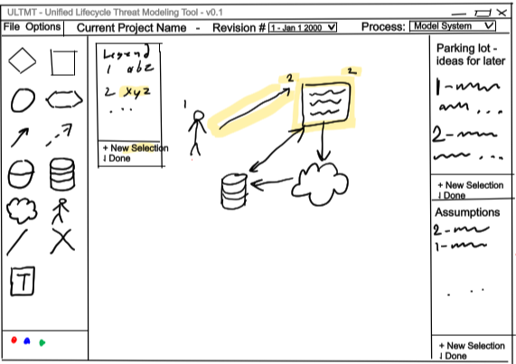
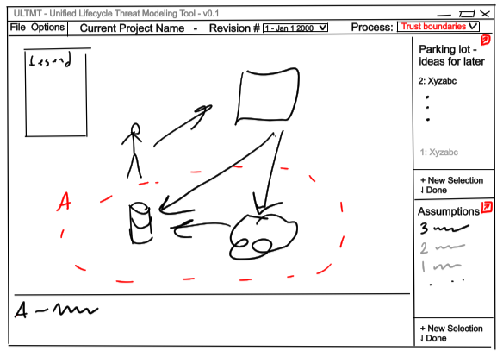
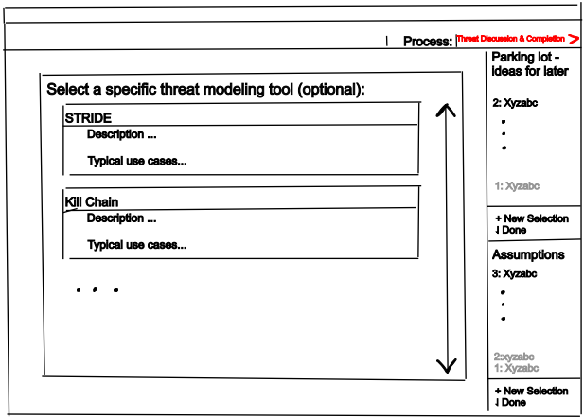
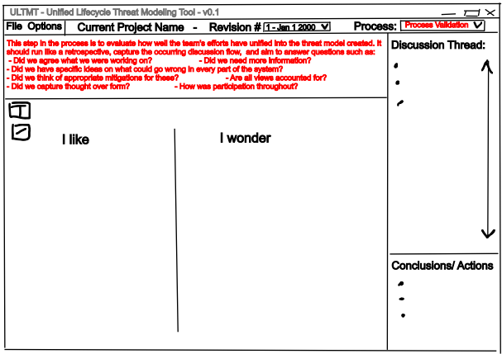
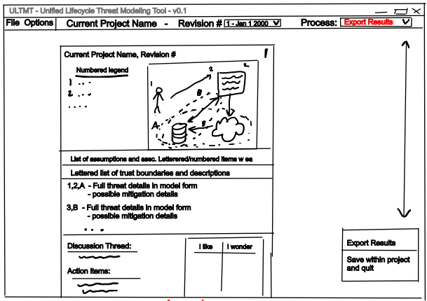

Design Details
Cooper Zuranski
Model System
Trust Boundaries
Threat Discussion and Completion
Model Confirmation
Process Validation
Export Results

Slide 12
System test Plan
Kris Bright
Mocha/Chai
Pros: | Cons:
Automated testing process Can continuously test or perform tests on-demand Can test complex functionality Human-readable syntax Free One team member has experience, though the experience is limited | Complicated syntax can be confusing for newer users Documentation isn’t always clear
JEST
Pros: | Cons:
Simple syntax that is human-readable Good documentation available online Can test complex functionality | No group member has experience
unittest
Pros: | Cons:
Automated testing process | No external plug-ins
PyTest
Pros: | Cons:
Automated testing process | Over 800 external plug-ins to speed up creation of test cases

Slide 13

Potential Risk and mitigation
Kris Bright
Little to no physical risk due as it’s purely software
Failing to make software easily extendable
Hidden software bugs
Issues with Version Control
Failing to meet basic constraints

Slide 14
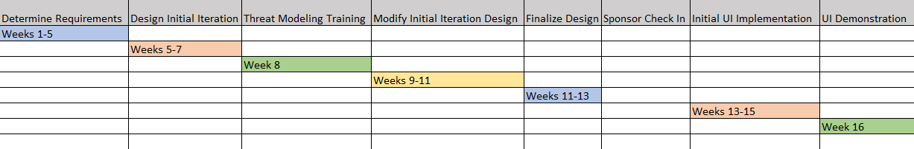
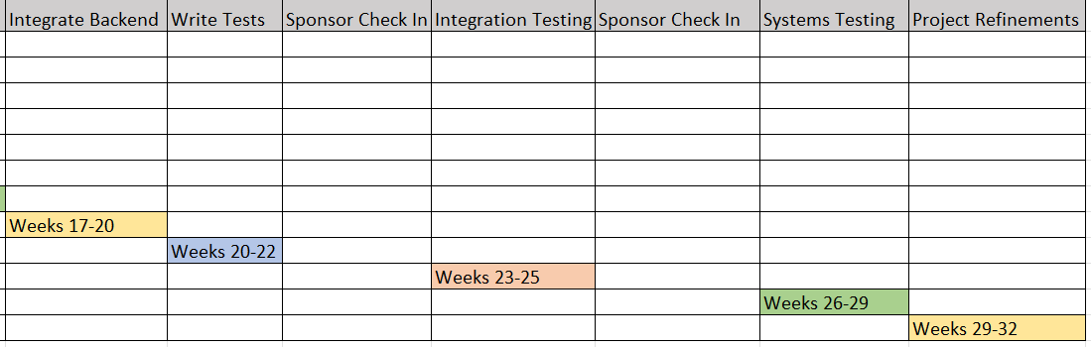
Project Plan
Kris Bright
Fig. Semester 1 Project Plan
Fig. Semester 2 Project Plan

Slide 15
Questions?

